Slide 1

BTech Thesis Project Presentation
Saumya Chaturvedi (2021UEA6510)
Swayam Bhageria (2021UEA6508)
Project Supervisor : Dr Aarti Jain

Slide 2
Schizophrenia Detection of EEG Signals using Deep Learning Neural Networks

Slide 3
Previous Work
Automated schizophrenia detection using EEG signals by CNN-LSTM model.
95.98% accuracy
10% increase over base paper
Dataset of 28 subjects, over 16 electrodes
Testing model performance on unseen data revealed bias
Possible overfitting
Small datasets struggle with generalization

Slide 4
Solution
A variety of methods explored - regularization, callbacks, dropout
Final approach - Data Augmentation
Extending the dataset
Encoder Decoder Architecture
Create meaningful variation of real EEG spectograms

Slide 5
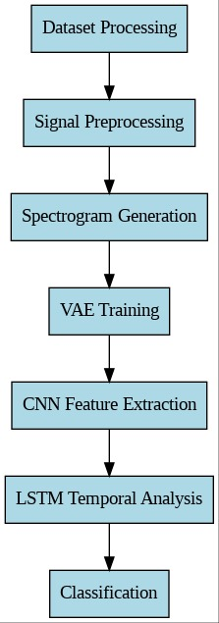
Proposed Methodology
Dataset Processing
Signal Preprocessing
Spectogram Generation
Variational Autoencoder (VAE) Training
CNN Feature Extraction
LSTM temporal analysis
Classification

Slide 6
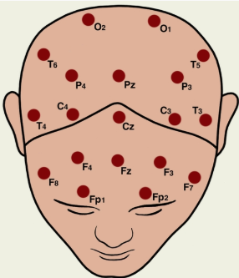
Dataset
from Laboratory for Neurophysiology and Neuro-Computer Interfaces, Moscow State University
Includes EEG recorded signals:
healthy (n = 39) and with symptoms of schizophrenia (n = 45).
Age between 13 and 17 years old (adolescents)
Sampling frequency: 128 Hz
16 channels (electrodes)
7680 samples represent 1 channel
source: M.V.Lomonosov Moscow State University

Slide 7
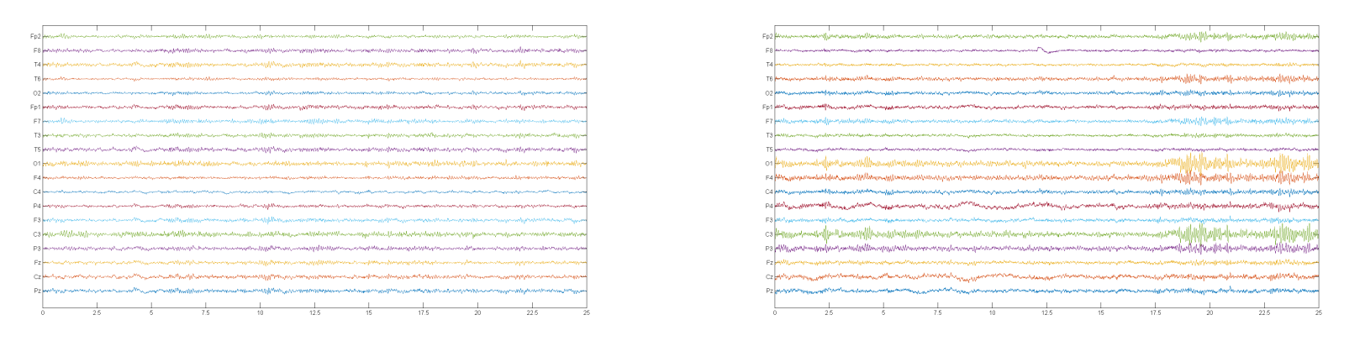
source: Shoeibi et al
EEG signals of schizophrenic patient
EEG signals of healthy patient
X-axis: time
Y-axis: EEG channel amplitude

Slide 8
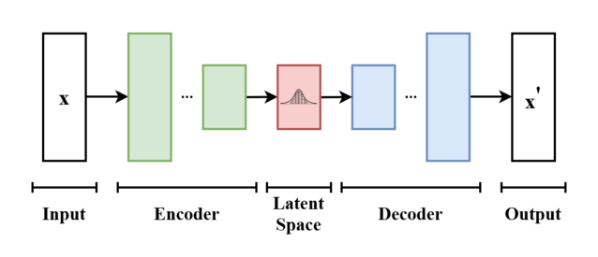
Variational Autoencoder
source: Wikipedia
Data Augmentation by probabilistic data reconstruction.

Slide 9
Components of VAE
Encoder:
Compresses input data into a lower-dimensional latent space.
Converts input data into a probabilistic distribution (mean and variance).
Latent Space Representation:
Stores learned distributions of features.
Similar EEG patterns cluster close together
Decoder:
Mirror of the encoder
Reconstructs the original data from the latent space.

Slide 10
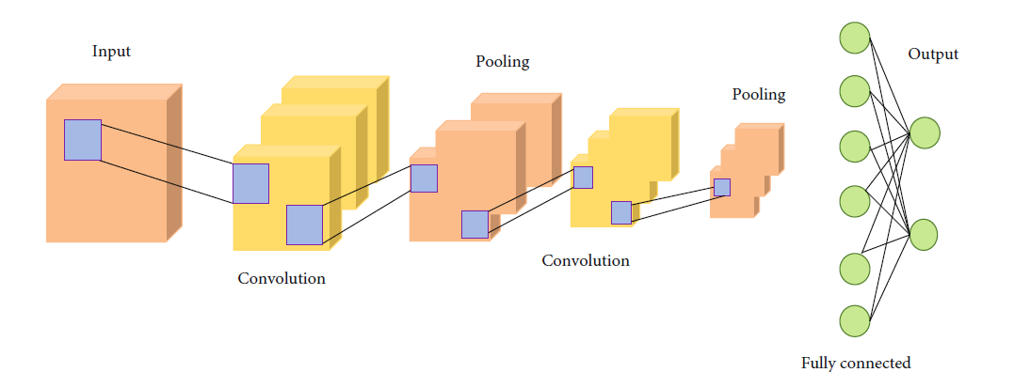
CNN
source: Zheng et al

Slide 11
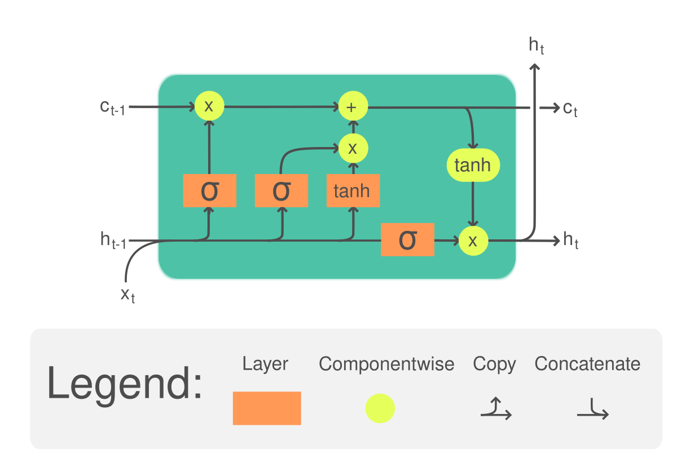
LSTM
source: mlarchive.com

Slide 12
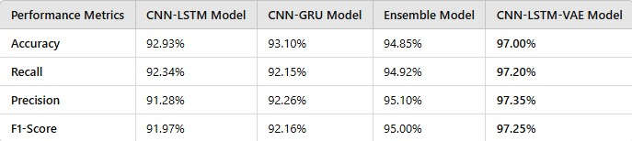
Comparison with base paper

Slide 13
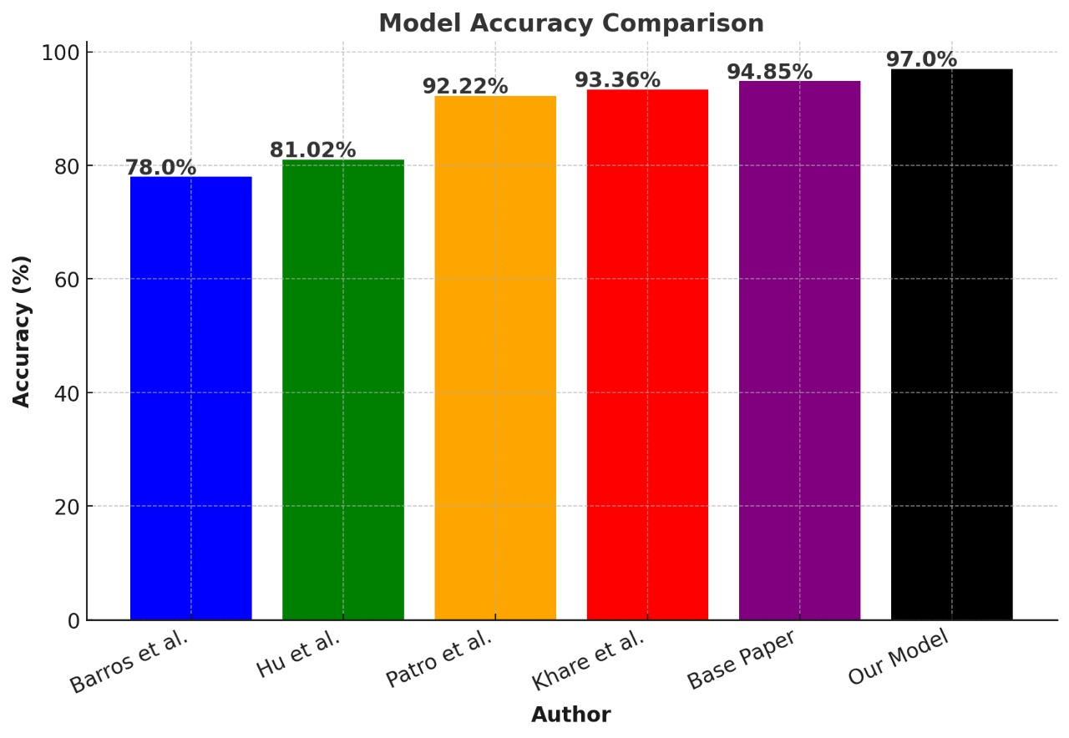
Model Comparison with Existing Research

Slide 14
Conclusion
CNN-LSTM model enhanced with VAE outperforms all existing models on classification of Schizophrenia patients
our model achieves high accuracy on lower training epochs and low memory requirements

Slide 15
Future Work
Extend the usecase to epilepsy detection, parkinsons detection and other neuroscientific problems.
Challenge the performance-efficiency tradeoff.

Slide 16
References
Dataset: Olejarczyk E, Jernajczyk W. Graph-based analysis of brain connectivity in schizophrenia. PLoS One. 2017 Nov 30;12(11):e0188629. doi: 10.1371/journal.pone.0188629. PMID: 29190759; PMCID: PMC5708839.
Sun, Jie, et al. "A hybrid deep neural network for classification of schizophrenia using EEG Data." Scientific Reports 11.1 (2021): 1-16.
Saeedi, M., Saeedi, A. \& Maghsoudi, A. Major depressive disorder assessment via enhanced knearest neighbor method and EEG signals. Phys Eng Sci Med 43, 1007–1018 (2020). https://doi.org/10.1007/s13246-020-00897-w
Shoeibi, A., Sadeghi, D., Moridian, P., Ghassemi, N., Heras, J., Alizadehsani, R., Khadem, A., Kong, Y., Nahavandi, S., Zhang, Y.-D., \& Gorriz, J. M. (2021). Automatic Diagnosis of Schizophrenia in EEG Signals Using CNN-LSTM Models. Frontiers in Neuroinformatics, 15. https://doi.org/10.3389/fninf.2021.777977
https://mlarchive.com/deep-learning/understanding-long-short-term-memory-networks/

